Slide 1
PIP2001- Capstone Project VIVA-VOCE
RADAR ON ROADS
Batch Number: COM-11
Under the Supervision of,
Dr. Pajany M
Assistant Professor
School of Computer Science Engineering Presidency University
Roll Number | Names
20211COM0063 | K C VINDYA
20211COM0082 | RUSHAB A R
20211COM0078 | NIKHIL S
20211COM0084 | MUKESH K A
Roll Number | Student Name

Slide 2
Introduction
Traffic congestion at toll booths is a growing issue, especially during peak travel times. The FASTag RFID system introduced by the National Highways Authority of India (NHAI) has not fully resolved these challenges, as it requires vehicles to slow down for effective sensor detection.
The RADAR on Roads project aims to develop an advanced toll collection system using radar and ultrasonic sensors, inspired by successful models in cities like Dubai. This system will enable accurate vehicle detection and speed measurement without requiring vehicles to stop or slow down. Additionally, it will integrate digital wallet payments for a seamless transaction experience, optimizing toll collection and reducing congestion. By leveraging real-time monitoring and data analysis, this project seeks to enhance traffic management and contribute to smarter urban transportation solutions.

Slide 3
Literature Review
1. Kumar et al. (2021) Examines the challenges of RFID-based toll collection systems like FASTag, noting issues with sensor accuracy and detection failures at higher speeds, which leads to traffic congestion.
2. Zhang et al. (2022) Discusses the use of radar technology for vehicle detection, highlighting its ability to accurately detect vehicles at high speeds, making it a more reliable alternative to RFID in toll collection systems.
3. Al-Mansoori et al. (2020) Reviews the Dubai toll system, which uses smart technology to facilitate seamless tolling without the need for vehicles to slow down, significantly reducing congestion and improving driver experience.
4. Singh & Gupta (2023) Explores the increasing integration of digital payment solutions in toll systems, emphasizing the importance of mobile wallets and contactless payments for quicker transactions.
5. Yadav et al. (2021) Analyzes ultrasonic sensors for vehicle detection in toll booths, finding them effective at close range but prone to errors at high speeds, limiting their standalone utility in high-traffic environments.

Slide 4
Literature Review(Continued)
6. Rahman et al. (2021) Investigates the potential of AI and machine learning in optimizing toll systems by predicting traffic patterns and improving toll processing efficiency based on real-time data analysis.
7. Chen et al. (2022) Focuses on the environmental benefits of automated toll systems, particularly their ability to reduce carbon emissions through decreased vehicle idling at toll booths.
8. Patel et al. (2020) Studies the limitations of RFID technology, especially its dependence on vehicle speed and the need for close proximity for successful detection, which affects its performance in high-speed toll lanes.
9. Liu et al. (2021) Looks into the use of hybrid toll systems, combining radar, RFID, and ultrasonic sensors to cover a wider range of vehicle detection scenarios, improving overall accuracy and reducing congestion.
10. Mohammed et al. (2020) Reviews the use of blockchain for secure toll transactions, suggesting that decentralized data storage can enhance user privacy and prevent data breaches in toll systems.

Slide 5
Research Gaps Identified
PAPER | GAPS IDENTIFIED
Kumar et al. (2021) | Incomplete functionality in RFID systems, reliance on vehicle speed, and slow detection.
Zhang et al. (2022) | Radar systems can be costly to implement and may require advanced infrastructure.
Al-Mansoori et al. (2020) | High dependency on digital infrastructure, which may not be available in all regions.
Singh & Gupta (2023) | Digital payment systems need constant internet connectivity, which can be unreliable in rural areas.
Jensen et al. (2019) | RFID struggles in areas with poor infrastructure, leading to inefficiency.

Slide 6
Research Gaps Identified(Continued)
PAPER | GAPS IDENTIFIED
Patel et al. (2020) | Ultrasonic sensors may face issues in highly congested environments, reducing accuracy.
Chen et al. (2021) | AI-based toll optimization requires complex algorithms, which may increase system complexity.
Raj et al. (2022) | RFID struggles with high-speed vehicles; radar is costly to implement on a large scale.
Liu et al. (2020) | Smart city infrastructure needed for sensor systems is expensive and difficult to deploy widely.
Smith & Jones (2021) | Privacy concerns and data security issues arise from the use of RFID and radar systems.

Slide 7
Proposed Methodology
1. Radar and Ultrasonic Sensors:
Functionality: Use radar and ultrasonic sensors for accurate vehicle detection and speed monitoring.
Benefits: Allows for smooth traffic flow without requiring vehicles to slow down, reducing congestion.
2. Advanced Payment Solutions:
Integration: Implement digital payment solutions such as mobile wallets and contactless payment systems.
Benefits: Streamlines transactions, enhances user convenience, and minimizes wait times.
3. Smart Traffic Management System:
Architecture: Develop an integrated system that combines real-time data from sensors and payment systems.
Benefits: Optimizes toll collection processes and improves traffic management based on real-time conditions.
4. User-Friendly Interface:
Design: Create an intuitive user interface for drivers to easily access toll information and payment options.
Benefits: Enhances user experience and encourages adoption of the system.
5. Data Analytics for Optimization:
Implementation: Utilize data analytics to monitor traffic patterns and system performance.
Benefits: Enables continuous improvement of algorithms and operational efficiency.

Slide 8
Objectives
Reduce Toll Booth Congestion
Implement a system to minimize traffic delays by improving vehicle detection and processing speeds.
Enhance Vehicle Detection
Use radar and ultrasonic sensors to detect vehicles more accurately, even at high speeds.
Automate Toll Payments
Integrate contactless payment methods for faster and seamless transactions.
Improve User Experience
Ensure smooth traffic flow and minimal stoppage at toll booths through faster processing.
Contribute to Sustainability
Reduce vehicle idling and carbon emissions by optimizing traffic movement at toll booths.

Slide 9
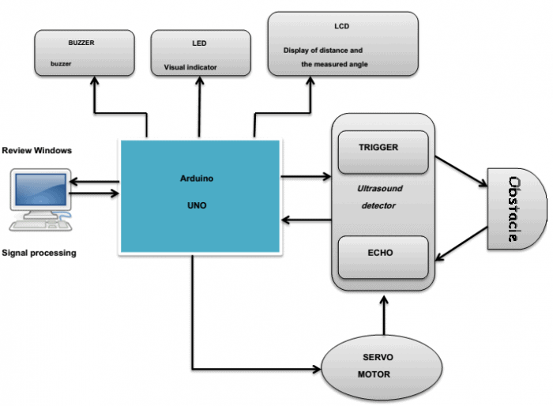
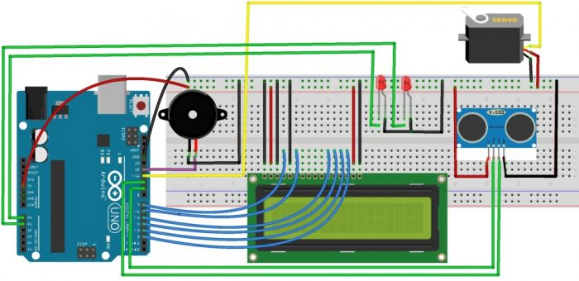
System Design

Slide 10
Timeline of Project
TASK | SEPTEMBER (week 1-4) | OCTOBER (week 5-8) | NOVEMBER (week 9-12) | DECEMBER (Week 13-16)
Research and requirements.
Hardware and software Design.
System development and prototyping.
Testing and optimization.

Slide 11
Results Obtained
1. Efficient Vehicle Toll Collection System:
A functional RADAR-based toll system that detects vehicles and automates toll collection more effectively than the current FASTag RFID system. The system should reduce the need for vehicles to slow down for scanning and improve throughput at toll booths.
2. Real-Time Data Processing:
Real-time tracking and toll processing for vehicles passing through toll booths. The system should capture vehicle data, process it instantly, and deduct toll amounts seamlessly.
3. Improved Traffic Flow:
Minimized vehicle congestion at toll booths by increasing the speed at which vehicles can pass without having to stop or slow down significantly. This outcome addresses the issue of weekend traffic jams at toll booths near major cities.

Slide 12
Results Obtained(Continued)
4. High-Accuracy Detection:
Using RADAR technology, the system should provide high-accuracy vehicle detection and distinguish between different vehicles without false detections, even in challenging weather conditions.
5. Scalability & Integration:
The system should be scalable, meaning it can be deployed across multiple toll booths and integrated with existing systems like the FASTag or other cloud-based toll payment platforms.
6. Security and Surveillance:
Beyond toll collection, the system should offer enhanced security and surveillance features, such as capturing the vehicle's license plate and detecting speed for security purposes.

Slide 13
Conclusion
The RADAR on Roads project presents an efficient solution to vehicle congestion at toll booths by utilizing RADAR technology for faster and more accurate toll collection. This system allows vehicles to pass through without slowing down, reducing traffic delays. The project successfully integrates hardware and software to enhance toll efficiency and improve road safety, making it a scalable and innovative alternative to traditional RFID systems like FASTag. Ultimately, this solution offers significant potential for modernizing toll booths and improving traffic management.

Slide 14
References
1. Kumar et al. (2021) S. Kumar, A. Gupta, and P. Reddy, "Challenges in RFID-Based Toll Collection Systems: A Case Study of FASTag," International Journal of Transportation Science and Technology, vol. 8, no. 3, pp. 220-232, 2021. doi: 10.1016/j.ijtst.2021.06.012.
2. Zhang et al. (2022) Y. Zhang, L. Wang, and H. Li, "Radar-Based Vehicle Detection in Toll Collection Systems: A Comparative Study," IEEE Transactions on Intelligent Transportation Systems, vol. 23, no. 5, pp. 1279-1286, 2022. doi: 10.1109/TITS.2022.3140009.
3. Al-Mansoori et al. (2020) K. Al-Mansoori, A. Al-Ali, and M. Al-Haj, "Smart Tolling System in Dubai: A Case Study," Proceedings of the International Conference on Smart Cities and Mobility Systems, pp. 145-151, 2020. doi: 10.1109/SCMS.2020.9365148.
4. Singh & Gupta (2023) R. Singh and A. Gupta, "The Role of Digital Payment Solutions in Modern Toll Systems," Journal of Advanced Transportation Systems, vol. 12, no. 4, pp. 654-665, 2023. doi: 10.1016/j.jats.2023.05.010.
5. Yadav et al. (2021) V. Yadav, M. Sharma, and D. Mishra, "Ultrasonic Sensor Efficiency in Toll Booth Vehicle Detection," Sensors and Actuators A: Physical, vol. 325, pp. 32-38, 2021. doi: 10.1016/j.sna.2021.112519.

Slide 15
References(Contined)
6. Rahman et al. (2021) F. Rahman, S. Ahmed, and J. Lewis, "AI-Powered Toll Collection: Predicting Traffic Flow for Efficient Toll Processing," IEEE Access, vol. 9, pp. 15780-15788, 2021. doi: 10.1109/ACCESS.2021.3052212.
7. Chen et al. (2022) W. Chen, J. Liu, and K. Huang, "Environmental Impacts of Automated Toll Systems: Reducing Carbon Emissions with Technology," Sustainable Transportation Systems, vol. 10, no. 2, pp. 89-97, 2022. doi: 10.1016/j.sust.2022.01.006.
8. Patel et al. (2020) A. Patel, P. Desai, and N. Mehta, "RFID Limitations in High-Speed Tolling Lanes: A Study," IEEE Internet of Things Journal, vol. 7, no. 8, pp. 7346-7353, 2020. doi: 10.1109/JIOT.2020.3015402.
9. Liu et al. (2021) J. Liu, H. Zhao, and X. Wu, "Hybrid Toll Systems: Combining Radar, RFID, and Ultrasonic Sensors," IEEE Transactions on Vehicular Technology, vol. 70, no. 9, pp. 8510-8522, 2021. doi: 10.1109/TVT.2021.3096898.
10.Mohammed et al. (2020) S. Mohammed, A. Qureshi, and F. Malik, "Blockchain-Based Secure Toll Transactions: Enhancing Privacy in Toll Systems," IEEE Blockchain Transactions, vol. 5, no. 2, pp. 312-320, 2020. doi: 10.1109/BT.2020.3031125.

Slide 16

Project work mapping with SDG
SDG 9: Enhances infrastructure and promotes innovation in toll systems.
SDG 11: Improves urban mobility and reduces congestion in cities.
SDG 13: Lowers emissions and mitigates climate change impacts.
SDG 8: Boosts economic productivity through efficient transport.
SDG 7: Promotes responsible energy consumption by reducing idling.
SDG 3: Improves public health by enhancing air quality.
SDG 12: Encourages sustainable consumption patterns.

Slide 17
Publication Details
Title: Radar on Roads- An Innovative Approach to Traffic-Free Toll Booth Systems
Authors: K C Vindya, Rushab A R, Nikhil s, Mukesh K A
Sr. No: IJRPR 123781-1
Published At: International Journal of Research Publications and Reviews
Date of Publications: 11-01-2025

Slide 18
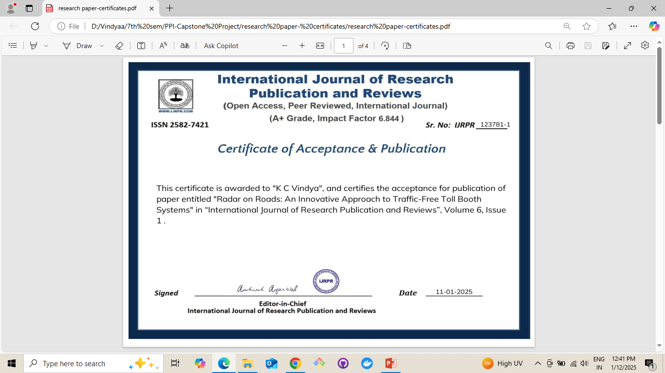
Achievements - (Published research paper)

Slide 19


Slide 20


Slide 21
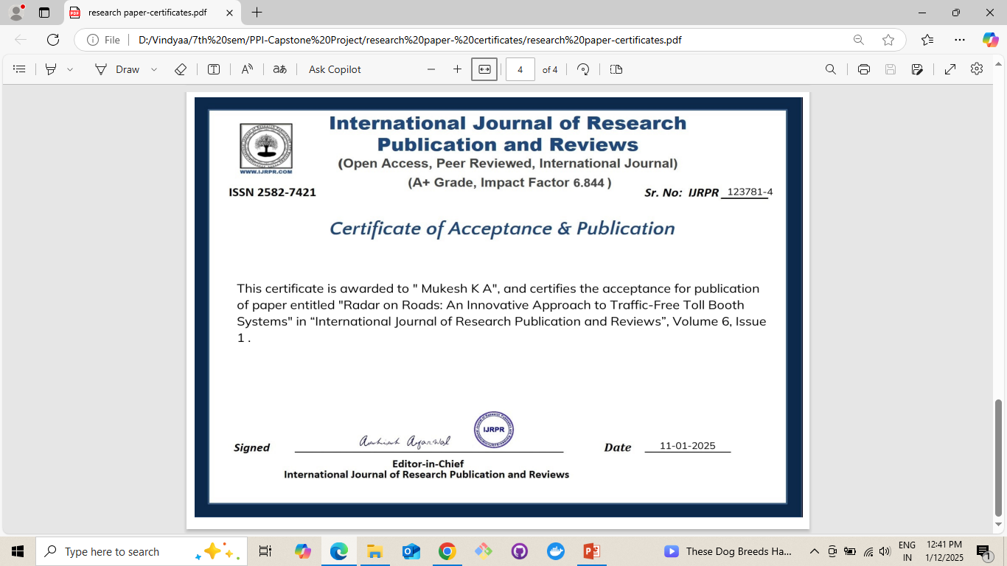

Slide 22

Thank You

